Slide 1

Web Application Development
COMP-229

Slide 2
Folder and file structure
The following folder structure containing files that are relevant to the MERN skeleton backend. With these files, we will have a functioning, standalone server-side application:

Slide 3
Folder and file structure
| mern_skeleton/
| -- config/
| --- config.js
| -- server/
| --- controllers/
| ---- auth.controller.js
| ---- user.controller.js
| --- helpers/
| ---- dbErrorHandler.js
| --- models/
| ---- user.model.js
| --- routes/
| ---- auth.routes.js
| ---- user.routes.js
| --- express.js
| --- server.js
| -- .babelrc
| -- nodemon.json
| -- package.json
| -- template.js
| -- webpack.config.server.js
| -- yarn.lock

Slide 4
Folder and file structure contd.
the configuration files in the root directory and the backend-related code in the server folder.
Create a folder called mern_Skeleton (you can give it any name)
Open the folder in vscode
At the terminal
Make a directory called server:
mkdir server
Then change directory to server:
cd server
Within the server folder, we will divide the backend code into modules containing models, controllers, routes, helpers, and common server-side code.
This folder structure will be further expanded where we'll complete the skeleton application by adding a React frontend.

Slide 5
Initializing the project
If your development environment is already set up, you can initialize the MERN project to start developing the backend.
First, we will initialize package.json in the project folder, configure and install any development dependencies, set configuration variables to be used in the code, and update package.json with run scripts to help develop and run the code.

Slide 6
Adding package.json
We will need a package.json file to store meta information about the project, list module dependencies with version numbers, and to define run scripts.
To initialize a package.json file in the project folder, go to the project folder cd to the server folder and run the command
yarn init
then follow the instructions to add the necessary details.
With package.json created, we can proceed with setup and development and update the file as more modules are required throughout code implementation.

Slide 7
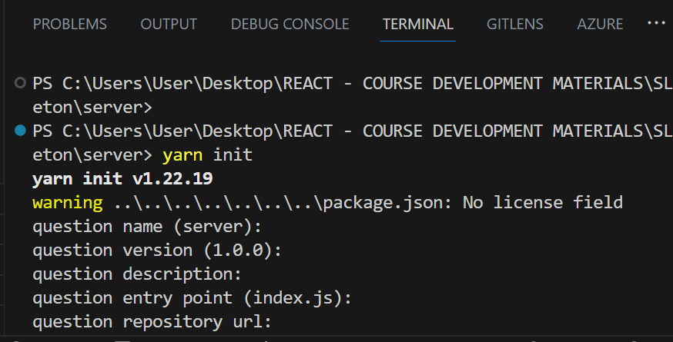
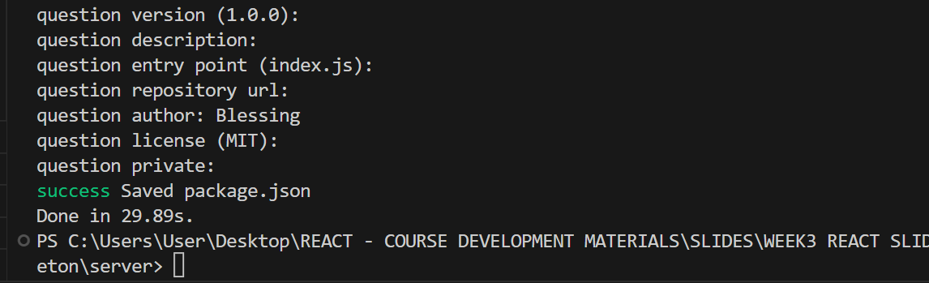
package.json contd.

Slide 8
Development dependencies
In order to begin the development process and run the backend server code, we will configure and install Babel and Nodemon.
Babel
Since we will be using ES6+ and the latest JS features in the backend code, we will install and configure Babel modules to convert ES6+ into older versions of JS so that it's compatible with the Node version being used.
we'll configure Babel in the .babelrc file with presets for the latest JS features and specify the current version of Node as the target environment.

Slide 9
Babel
mern-skeleton/server/.babelrc:
{
"presets": [
["@babel/preset-env",
{
"targets": {
"node": "current"
}
}
]
]
}

Slide 10
Babel update
Update Babel with this new code.
mern_skeleton/server/.babelrc
{
"presets": [
["@babel/preset-env",
{
"targets": {
"node": "current"
}
}
],
"@babel/preset-react"
],
"plugins": [
"react-hot-loader/babel"
]
}

Slide 11
Babel Contd.
In this configuration, we specify that we need Babel to transpile the latest
JavaScript syntax with support for code in a Node.js environment and also
React/JSX code. The react-hot-loader/babel plugin is required by the react-hot- loader module to compile React components

Slide 12
Babel Contd.
Setting targets: node to current instructs Babel to compile against the current version of Node and allows us to use expressions such as async/await in our backend code.
Next install the Babel modules as devDependencies in the server folder (cd server):
yarn add --dev @babel/core babel-loader @babel/preset-env
Once the module installations are done, you will notice that the devDependencies list has been updated in the package.json file.

Slide 13
Nodemon
Create a nodemon.json file in your project folder and add the following configuration:
{
"verbose": false,
"watch": [ "./server" ]
}

Slide 14
Nodemon
To automatically restart the Node server as we update our code during development, we will use Nodemon to monitor the server code for changes. Install it using the command below at the server side (cd server):
yarn add nodemon
Before we add run scripts to start developing and running the backend code, we will define configuration variables for values that are used across the backend implementation.

Slide 15
Nodemon contd.
mern_skeleton/server/nodemon.json:
{
"verbose": false,
"watch": [ "./server" ]
}

Slide 16
Config variables
In the config/config.js file, we will define some server-side configuration-related variables that will be used in the code but should not be hardcoded as a best practice, as well as for security purposes.

Slide 17
Config variables
mern-skeleton/server/config/config.js:
const config = {
env: process.env.NODE_ENV || 'development’,
port: process.env.PORT || 3000,
jwtSecret: process.env.JWT_SECRET || "YOUR_secret_key",
mongoUri: process.env.MONGODB_URI ||
process.env.MONGO_HOST ||
'mongodb://' + (process.env.IP || 'localhost') + ':' +
(process.env.MONGO_PORT || '27017') +
'/mernproject’
}
export default config

Slide 18
Config variables contd.
The config variables that were defined are as follows:
env: To differentiate between development and production modes
port: To define the listening port for the server
jwtSecret: The secret key to be used to sign JWT
mongoUri: The location of the MongoDB database instance for the project
These variables will give us the flexibility to change values from a single file and use it across the backend code.
Next, we will add the run scripts, which will allow us to run and debug the backend implementation.

Slide 19
Running scripts
To run the server as we develop the code for only the backend, we can start with
the yarn development script in the package.json file. For the complete skeleton application.
mern-skeleton/server/package.json:
"scripts": {
"development": "nodemon"
}

Slide 20
Running scripts – update the package.json code as follows:
{
"name": "server",
"version": "1.0.0",
"main": "index.js",
"author": "Blessing",
"license": "MIT",
"devDependencies": {
"@babel/core": "^7.22.5",
"@babel/preset-env": "^7.22.5",
"babel-loader": "^9.1.2"
},
"dependencies": {
"nodemon": "^2.0.22"
},
"scripts": {
"development": "nodemon"
}
}

Slide 21
Running scripts
With this script added, run
yarn development in the server side (cd server) command line from your project folder will basically start Nodemon according to the configuration in nodemon.json.
Run in the server side (cd server)
yarn add development
The configuration instructs Nodemon to monitor server files for updates and, on update, to build the files again, then restart the server so that the changes are immediately available.

Slide 22
Preparing the server
we will integrate Express, Node, and MongoDB in order to run a completely configured server before we start implementing user-specific features.

Slide 23
Configuring Express
To use Express, we will install it and then add and configure it in the server/express.js file.
From the command line, run the following command to install the express module and to have the package.json file automatically updated:
In the server side cd server run the following command:
yarn add express
Once Express has been installed, we can import it into the express.js file,
configure it as required, and make it available to the rest of the app.

Slide 24
Configuring Express contd.
Creating the express.js file in the server folder
mern_skeleton/server/express.js:
import express from 'express’
const app = express()
/*... configure express ... */
export default app

Slide 25
Configuring Express contd.
To handle HTTP requests and serve responses properly, we will use the following modules to configure Express:
body-parser: Request body-parsing middleware to handle the complexities of parsing streamable request objects so that we can simplify browser-server communication by exchanging JSON in the request body. To install the module, run
yarn add body-parser
In the server side (cd server). Then, configure the Express app with bodyParser.json() and bodyParser.urlencoded({ extended: true }).

Slide 26
Configuring Express contd.
cookie-parser: Cookie parsing middleware to parse and set cookies in request objects. To install the cookie-parser module, run
yarn add cookie-parser
from the server side (cd server) command line.
compression: Compression middleware that will attempt to compress response bodies for all requests that traverse through the middleware. To install the compression module, run
yarn add compression
from the server side (cd server) command line.

Slide 27
Configuring Express contd.
helmet: Collection of middleware functions to help secure Express apps by setting various HTTP headers/ To install the helmet module, run
yarn add helmet
from the server side (cd server) command line.
cors: Middleware to enable cross-origin resource sharing (CORS). To install the cors module, run
yarn add cors
from the server side (cd server) command line.

Slide 28
Configuring Express contd.
After the preceding modules have been installed,
Update express.js to import these modules
Configure the Express app before exporting it for use in
the rest of the server code.

Slide 29
Configuring Express contd.
The updated mern-skeleton/server/express.js code should be as follows:
import express from 'express'
import bodyParser from 'body-parser'
import cookieParser from 'cookie-parser'
import compress from 'compression'
import cors from 'cors'
import helmet from 'helmet'
const app = express()
app.use(bodyParser.json())
app.use(bodyParser.urlencoded({ extended: true }))
app.use(cookieParser())
app.use(compress())
app.use(helmet())
app.use(cors())
export default app

Slide 30
Configuring Express contd.
The Express app can now accept and process information from incoming HTTP requests, for which we first need to start a server using this app.

Slide 31
Starting the server
With the Express app configured to accept HTTP requests, we can go ahead and use it to implement a server that can listen for incoming requests.
In the mern-skeleton/server/server.js file, add the following code to implement the server
import config from './../config/config'
import app from './express'
app.get("/", (req, res) => {
res.json({ message: "Welcome to User application." });
});
app.listen(config.port, (err) => {
if (err) {
console.log(err)
}
console.info('Server started on port %s.', config.port)
})

Slide 32
index.js
Notice in the package.json file the entry point to our application is index.js file, we will have to create the index.js file and configure the port number for our server.
mern_skeleton/server/index.js
const express = require('express');
const app = express();
const port = 3000;
// Add your server routes and middleware here
// For example:
app.get('/', (req, res) => {
res.send('Hello, world!');
});
app.listen(port, () => {
console.log(`Server is running on port ${port}`);
});

Slide 33
Starting the server
First, we import the config variables to set the port number that the server will listen on and then import the configured Express app to start the server.
To get this code running and continue development, we can run
yarn development
from the server. If the code has no errors, the server should start running with Nodemon monitoring for code changes.
Next, we will update this server code to integrate the database connection.

Slide 34
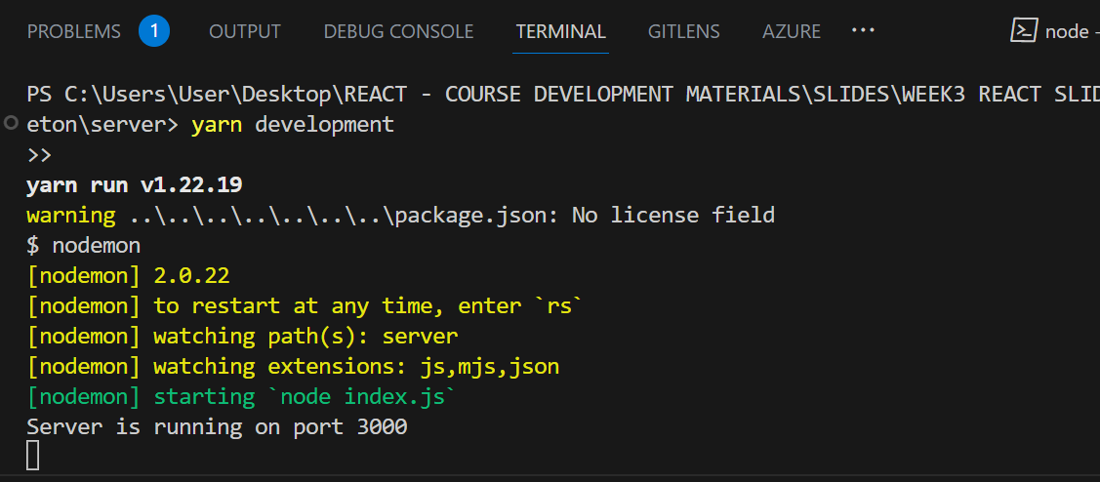
Output in the console

Slide 35
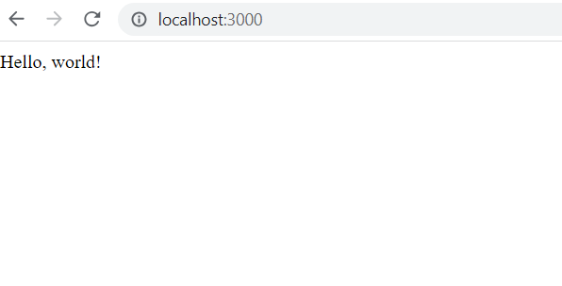
Output in the Browser window

